Slide 1
Chapter 10:
Introduction to Components

Slide 2
Objectives
To understand the benefits of components
To understand what components consist of
To understand the phases of component's lifetime

Slide 3
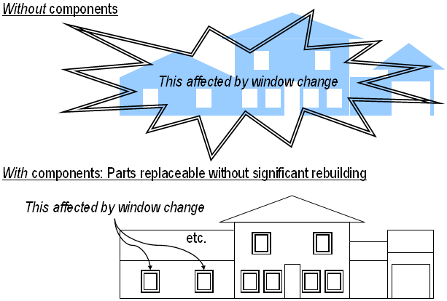
Introduction
A straightforward kind of reuse is one in which we do not alter the element being reused.
  Component technology uses this approach.

Slide 4
Definition of Components
No standard definition (or terminology) at present.
A simple, intuitive (obvious?) one might be:
  “A component is a reusable block of software.”

Slide 5
Characteristics of a Component
To qualify as a software component, a piece of software should have the following characteristics:
  Encapsulation: its inner workings must be hidden from the outside world that it exists in
  Use of an Interface:
    A useful interface which the outside world can interpret so that other components know what services it exports
    The interface should also specify what the component needs to import in order to carry out its operations
    The interface must conform to the component model (the accepted standard used in the world in which the component works)

Slide 6
Characteristics of a Component (Cont’d)
  Reusable: in different application contexts, so that developers can reduce the effort in developing new applications
  Replaceable:
    Able to replace, or be replaced by, other existing components
    The new component must at least be able to provide the same services as the old component
  Inter-operable: its services must be accessible on any platform

Slide 7
Software Components
So a software component is really like a hardware component.
It should be a black-box, with only its interface to define:
  What services it requires
  What services it can provide
  How the provided services can be accessed by other (compatible) components
  Where the component can be deployed

Slide 8
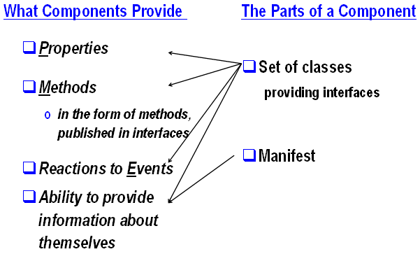
What Components Consist of

Slide 9
Manifests
Identification of the component
Authorship of the component
List of files or classes making up this component
Other components on which this one relies
Encryption information
Means of verifying that all parts of the component are present
Version number

Slide 10
Introspection and Metadata
Metadata
  Details concerning the classes that make up each component.
Introspection:
  The process of obtaining the metadata.
  The ability of components to provide information about themselves
Class | Name, superclass, super-interfaces, inner classes, fields, constructors, Methods
Field | Name, type
Constructor | Parameters, exceptions
Method | Name, parameters, return type, exceptions

Slide 11
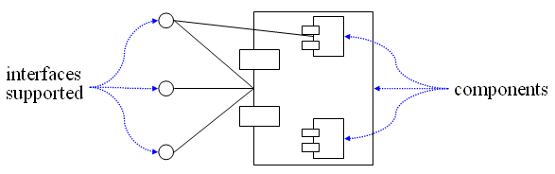
UML Component Notation

Slide 12
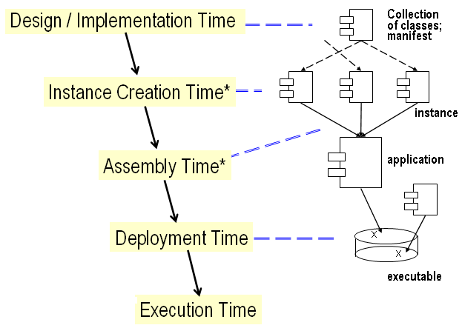
Phases of a Component’s Lifetime

Slide 13
Design/Implementation Phase
Write source code for classes
  Ensure that the runtime environment contains library classes required
  Conform with required rules, if any (e.g., Java Beans)
Incorporate required non-library classes
Create a manifest listing the component’s parts

Slide 14
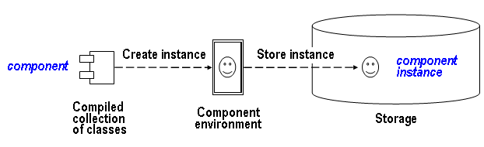
Instance Creation Phase
We do not write source code to create an instance; instead we do it through the component environment.

Slide 15
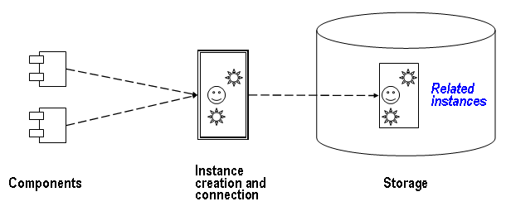
Assembly Phase
Put component instances together.

Slide 16
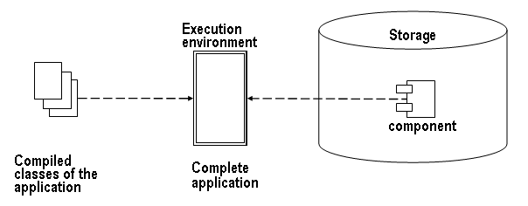
Deployment Phase
The process of placing components in operating environment.

Slide 17
Execution Phase
Ensure that all of the required parts are present in the environment to allow the application to execute.

